Slide 1
Generate JSON dari PHP
Matakuliah Advance Web Programming 2
Dosen Pengampu: Khoirul Umam, M.Kom
S1 Teknik Informatika STIKOM PGRI Banyuwangi

Slide 2
ContOh
<?php
$x = array("Jakarta","Banten","Bandung","Semarang","Yogyakarta","Surabaya");
header('Content-Type: application/json');
echo json_encode($x);
?>
Simpan dengan nama encode.php

Slide 3
Simpan File Script berikut di dalam folder yang sama dengan encode.php
<!DOCTYPE html>
<html>
<head> <title>Baca Data JSON dari Hasil Encoding</title> </head>
<body> <div id="data"></div> </body>
<script type="text/javascript" src="http://code.jquery.com/jquery-3.1.1.min.js"></script>
<script type="text/javascript">
var source = "http://localhost/json/encode.php";
$.getJSON(source,function(data){
$.each(data,function(i,d){
$("#data").append(++i + ". " + d + "<br />");
});
});
</script>
</html>

Slide 4
Modifikasi encode.php
<?php
$x = array( "dki" => "Jakarta",
"banten" => "Serang",
"jabar" => "Bandung",
"jateng" => "Semarang",
"diy" => "Yogyakarta",
"jatim" => "Surabaya");
header('Content-Type: application/json');
echo json_encode($x);
?>

Slide 5
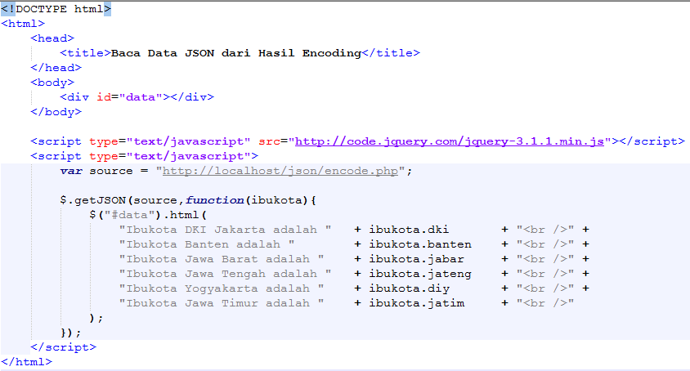

Slide 6
Modifikasi encode.php
<?php
$x = array(array("nama" => "DKI Jakarta", "ibukota" => "Jakarta"),
array("nama" => "Banten", "ibukota" => "Serang"),
array("nama" => "Jawa Barat", "ibukota" => "Bandung"),
array("nama" => "Jawa Tengah", "ibukota" => "Semarang"),
array("nama" => "DI Yogyakarta", "ibukota" => "Yogyakarta"),
array("nama" => "Jawa Timur", "ibukota" => "Surabaya")
);
header('Content-Type: application/json');
echo json_encode($x);
?>

Slide 7
